Slide 1

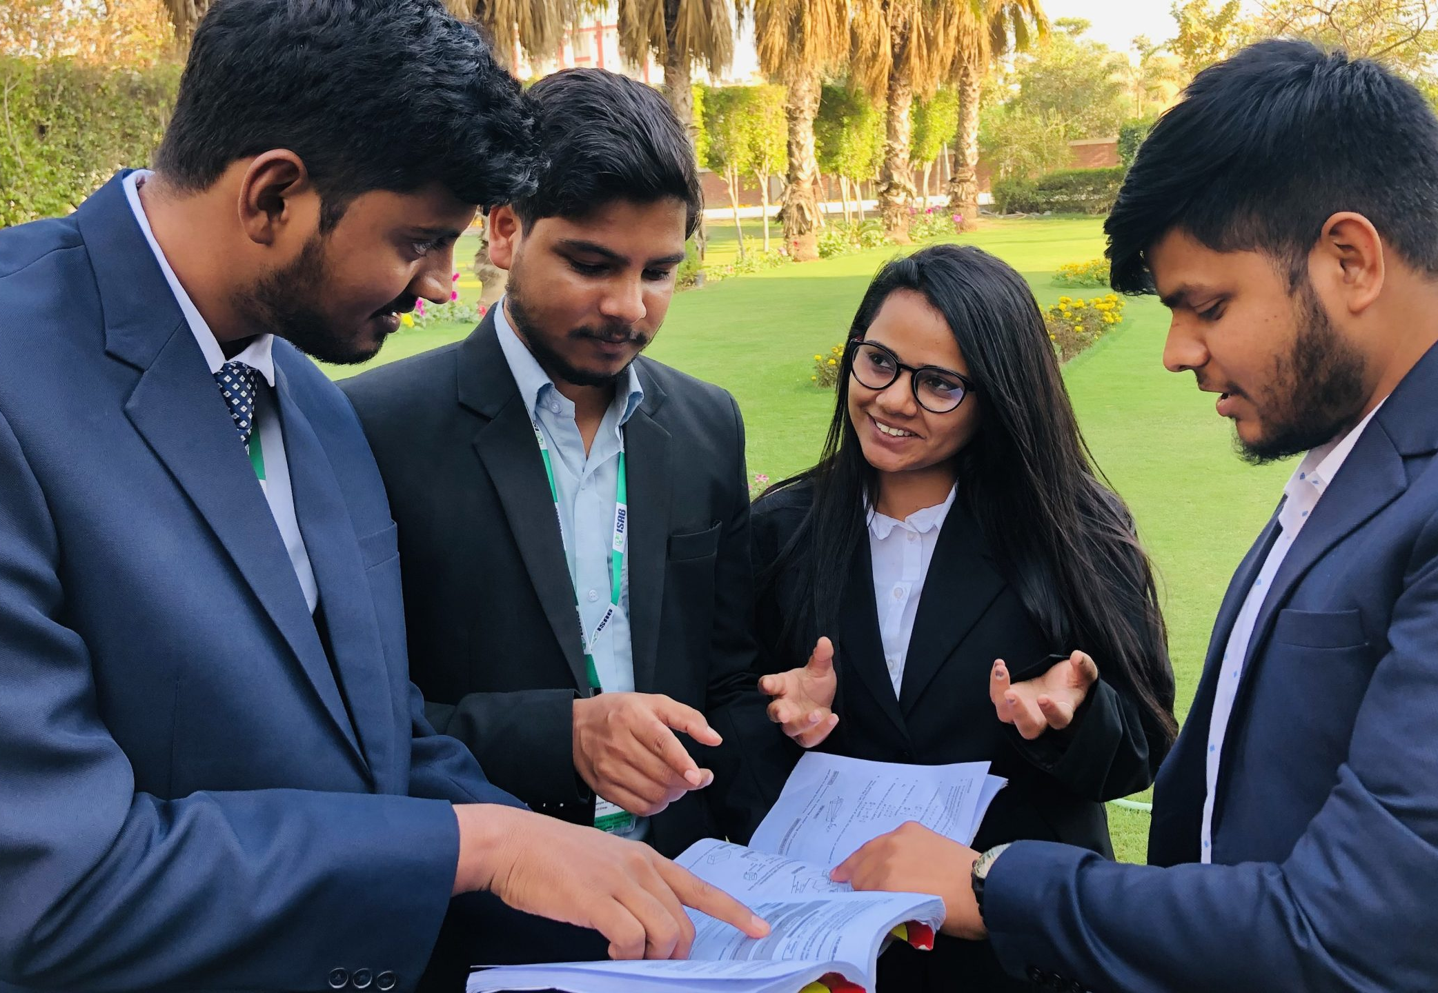

FINAL PLACEMENT REPORT batch 2020-2022
2
+
2
+
IMPERIAL SCHOOL OF AGRI BUSINESS
MBA – FOOD & AGRIBUSINESS
100 % PLACEMENT RECORD IN TOP BRANDS

Slide 2
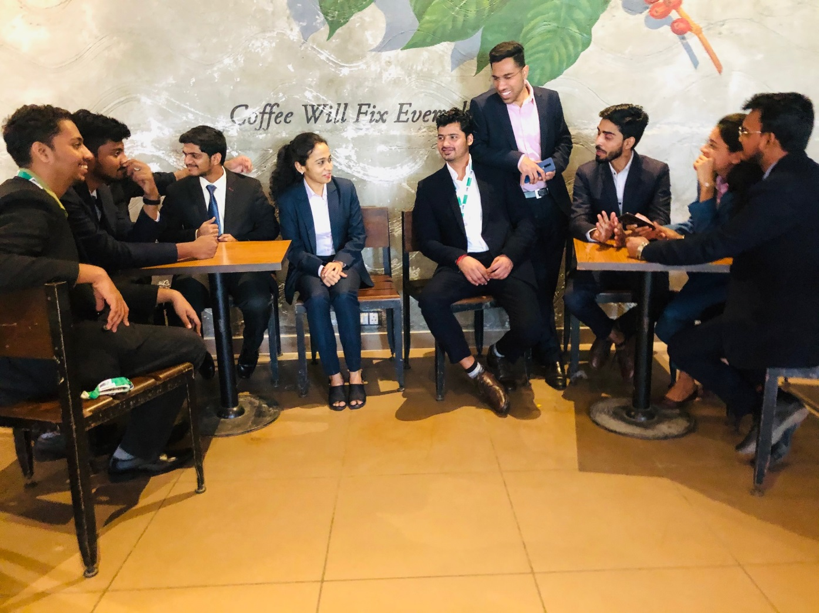
Table of Contents
Overview
Placement Secretary Message
Batch Statistics
Key placement statistics
Domain Wise statistics
First time recruiters
Other legacy recruiters
Final placement geographic representation
Vote of Thanks
2020-22 batch final placement recruiters
Placement team details
2
+
Notes:
1- Existing placement cell photo if wish to in the background
2- Bring uniformity in titles across slides

Slide 3
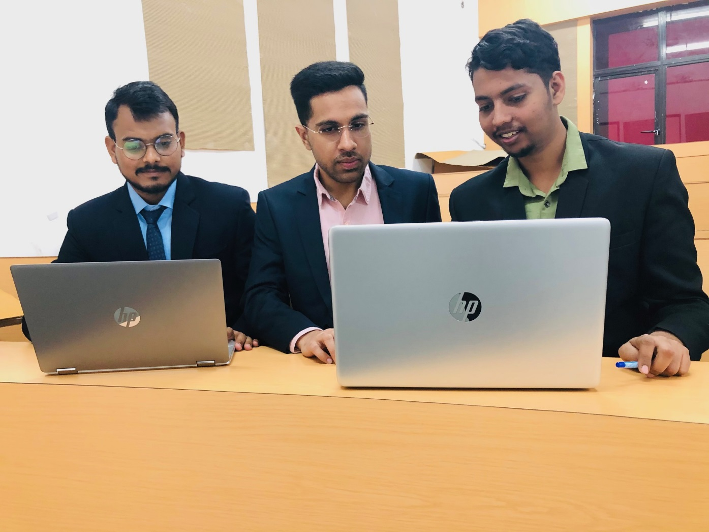
Overview
2
+
Imperial School of Agribusiness, Greater Noida has successfully concluded it's final placement drive for 2020-22 batch .All the students of ISAB successfully got placed in the esteemed agriculture and allied organizations. Recruiters from more than 20 companies participated in the placement procedure this year. A bunchful of Agriprenuer Ventures also participated in the placement drive for the very first time this year. The companies provided various job roles to the candidates varying from research analyst to the sales person and from finance sector to other operational jobs. The entire cycle got completed in 3 months from January to March. The process was expected to be completed earlier but the covid's 3rd wave laid to some delay but ultimately the institution got the landmark achievement by the endless efforts of placement cell and the entire ISAB fraternity. ISAB is crystal clear in its mission and vision to repeat such achievement each and every year with it's unbiased and honest efforts . It is carrying it's legacy of 15 years together and putting hard efforts to maintain it always on the top of the toast.

Slide 4
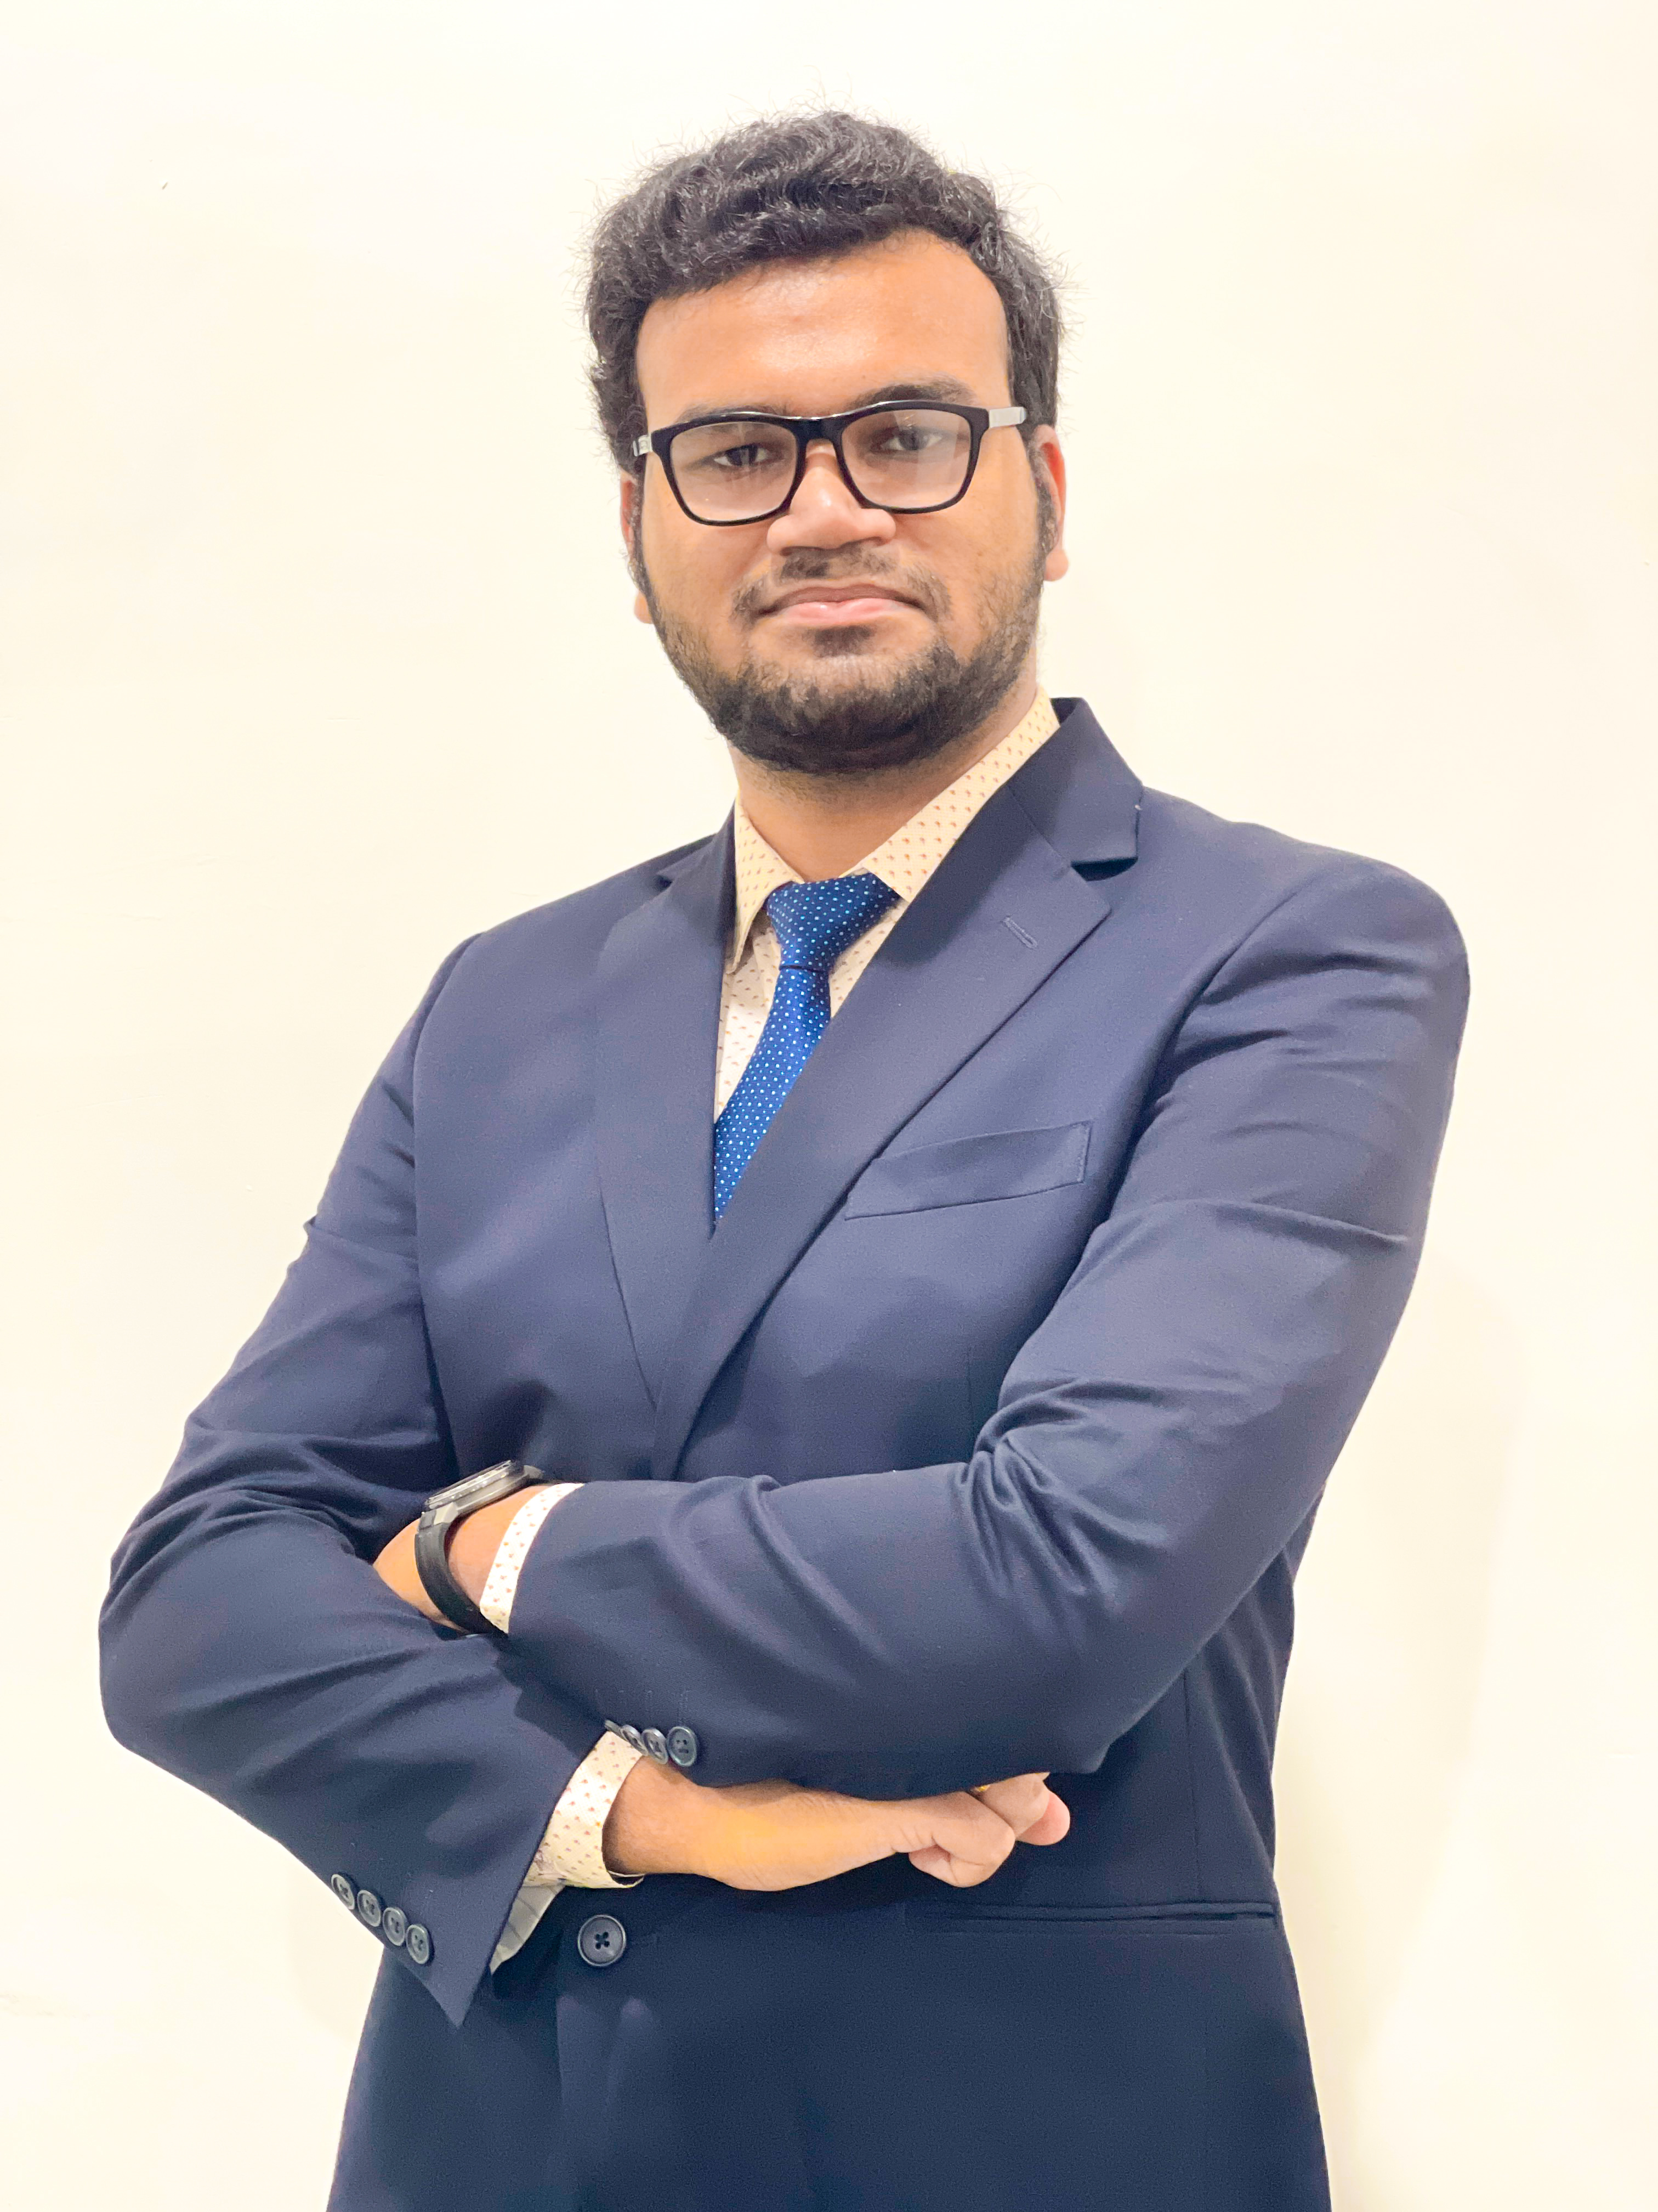
PLACEMENT SECRETARY’S MESSAGE
ISAB committed and proactive in satisfying industry needs for talent perceived in the corporate. We are talented pool of dedicated and dynamic final year students, prepared to hit the corporate arena as full-time workforce. In our curriculum, we seek to open frontiers of knowledge and reveal new horizons of change, to broaden mindsets and to create a positive attitude in our students.
Apart from the curriculum, our students are also exposed to rich industrial experience by means of guest lectures, live industrial projects and visits. Our ISAB Institution has made constant efforts to provide knowledge-based expert services for satisfying the needs of the industry and thus helping in building a positive attitude in the young minds of this generation and prepare the youths to face the challenges of the corporate world.
My gratitude is due to our regular recruiters who have shown consistent faith in the institute’s value system. Also, with great warmth, I graciously welcome our new recruiters who have joined us this season and look forward to an everlasting symbiotic relationship with them.
Vishal Pathak
Placement Secretary,
MBA-FABM 2021-23
Notes:
1- Check font size and type for uniformity
2- Final Placement Poster / Banner with Updated companies after placement secretary’s message

Slide 5
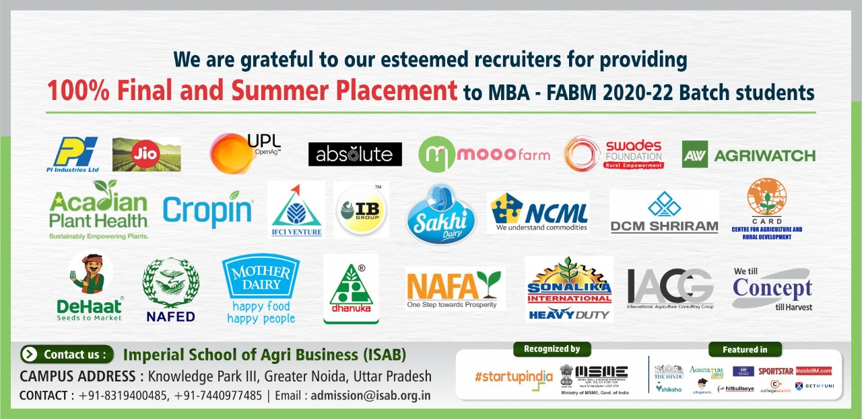
Notes:
Update this poster

Slide 6

BATCH STATISTICS
Gender
diversity
EDUCATIONAL BACKGROUND
WORK EXPERIENCE
Academic Background
Agriculture
80.08 %
Agri Engineering
4.80 %
Food Processing
4.80 %
Allied
9.60 %

Slide 7




Geographical
Representation
Uttarakhand
1
Uttar Pradesh
3
Punjab
Madhya Pradesh
3
1
Nagaland
1
Rajasthan
1
Telangana
3
Maharashtra
1
Odisha
1
Andhra Pradesh
4
Kerala
2

Slide 8
KEY PLACEMENT STATISTICS
Average CTC
5.20 LPA
CTC Range from
3.00 LPA to 7.5 LPA
Notes:
1- Not updated. Missed the new companies
2- Updated CTC LPA , CTC range to be updated
3- Sector wise placement % - Graphical format pie chart

Slide 9















Domain wise statistics
AGRI INPUT
DAIRY & POULTRY
NGO’S
TOP RECUITERS
TOP RECUITERS
TOP RECUITERS
Notes:
Missing Srinivasa
One box for Ag tech Companies for Dehaat, Cropin , Absolute Foods

Slide 10








FARM MACHINERY
FINANCE
CONSULTING
TOP RECUITERS
TOP RECUITERS
TOP RECUITERS
IT/E-COMMERCE
TOP RECUITERS
Notes:
Box should look equal , missing Poultry
Escorts Crop Solutions
Jio should go in ag tech folder

Slide 11
FIRST TIME RECRUITERS WHO VISITED ISAB
Notes:
Update this slide with new logo

Slide 12





































OTHER LEGACY RECRUITERS
Notes:
Uniform headings and other formatting

Slide 13

Vote of thanks
We are happy, humbled and proud on the same time to achieve the milestone of 100% Final Placement for all the MBA-Food & Agribusiness Management(FABM) students of 2020-22 Batch in prominent companies despite the limitations posed by the pandemic.
We are grateful to all our esteemed recruiters for extending opportunity to ISAB students to learn and excel in their careers. We thank all the prestigious recruiters for adding our institute to their campus recruitment portfolio and allowing us to continue our efforts at maintaining our relationship with them for subsequent cycles as well.
We would like to express our heartfelt gratitude to the Director & Co-founder, entire faculty, campus management and students whose dedicated efforts went into leading this placement season.
ISAB is committed to secure assured and bright career for its students to kick start their professional journey.
Notes:
Centrally Justify for formatting

Slide 14

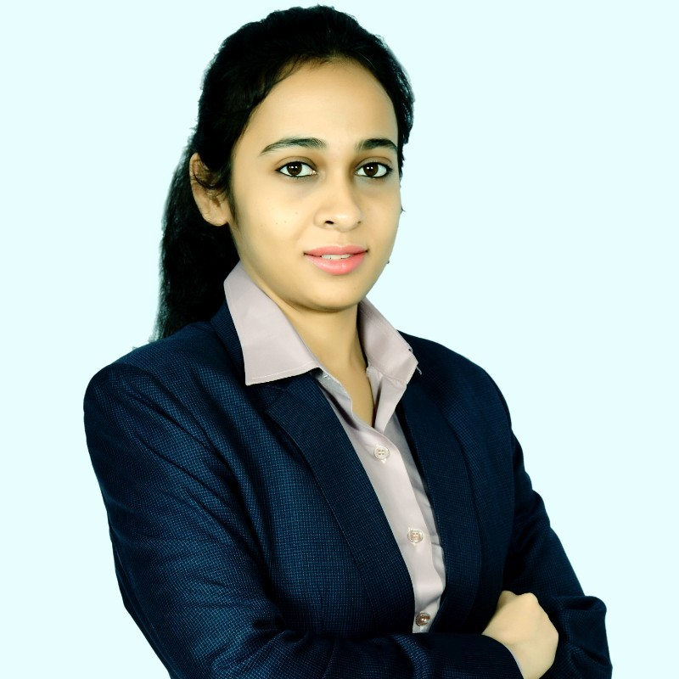
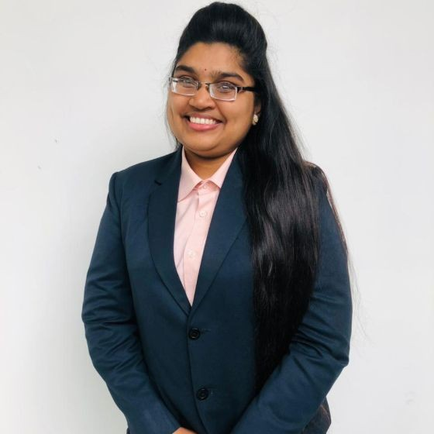
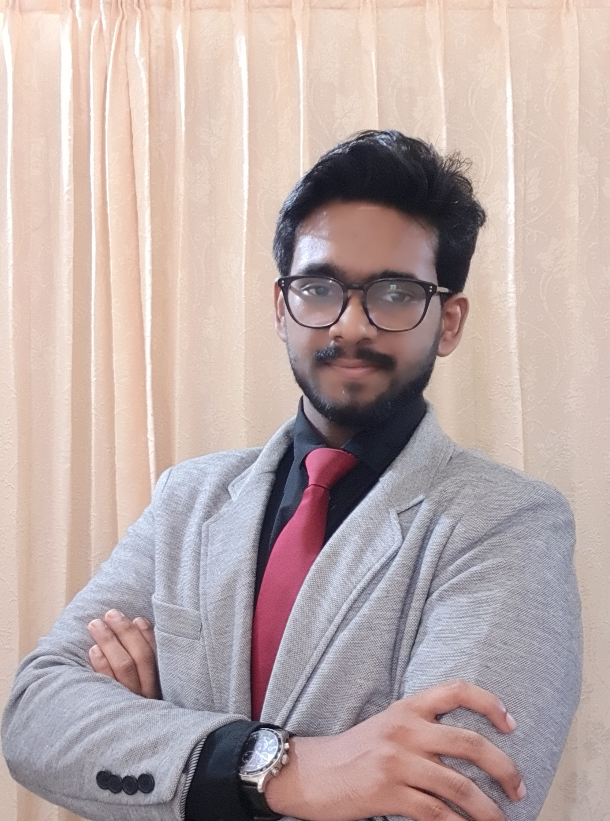

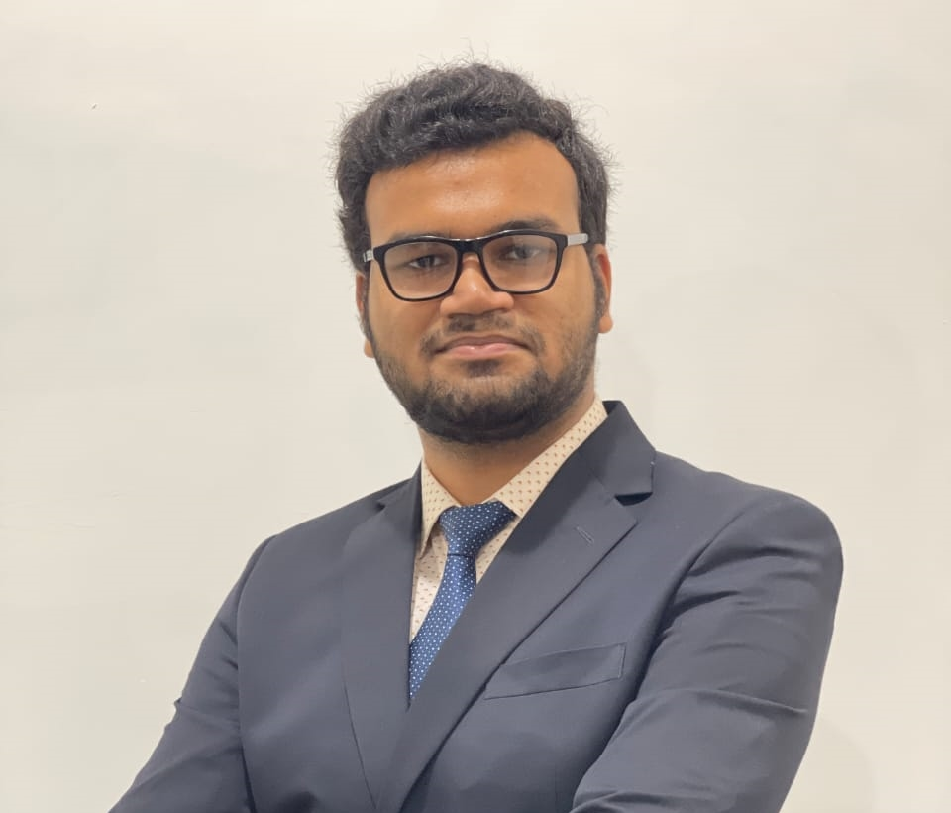

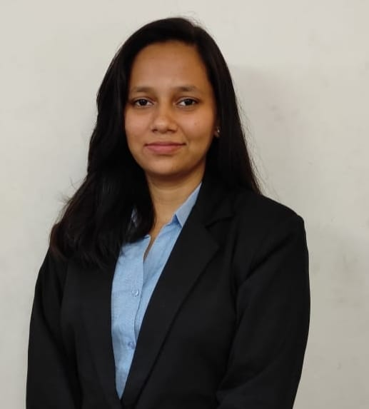
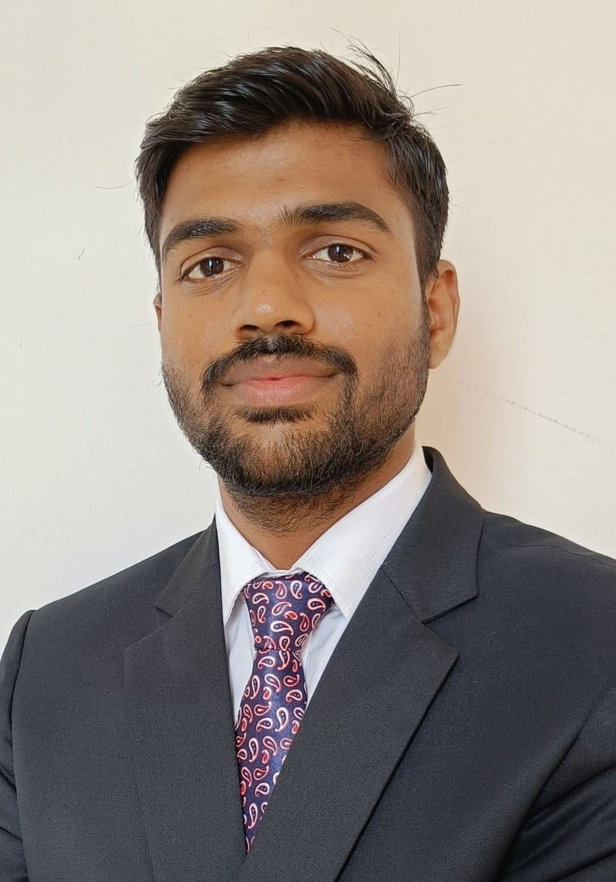
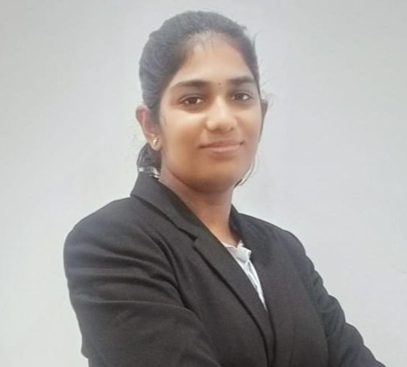
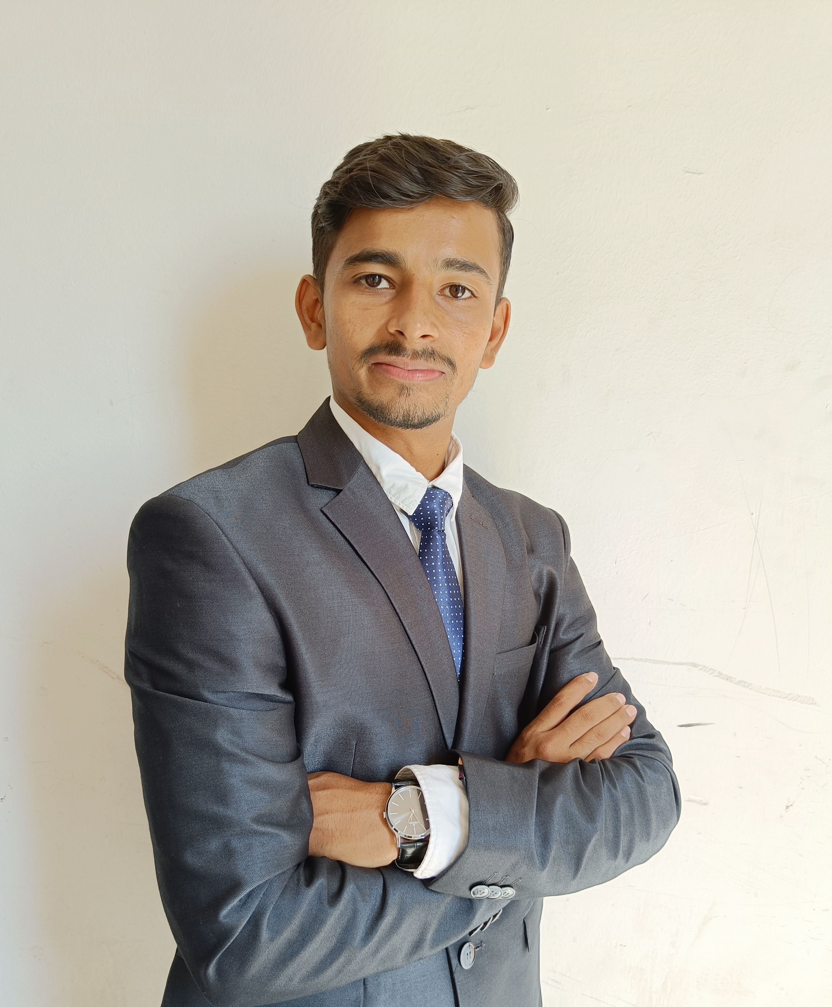
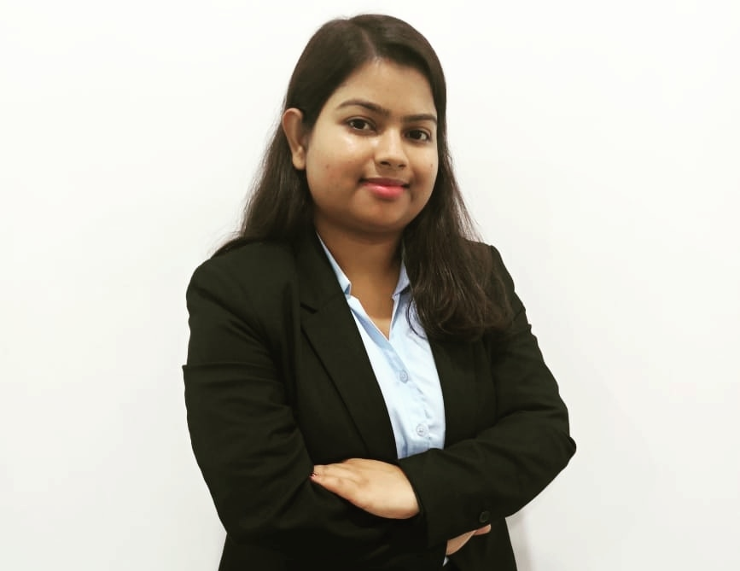
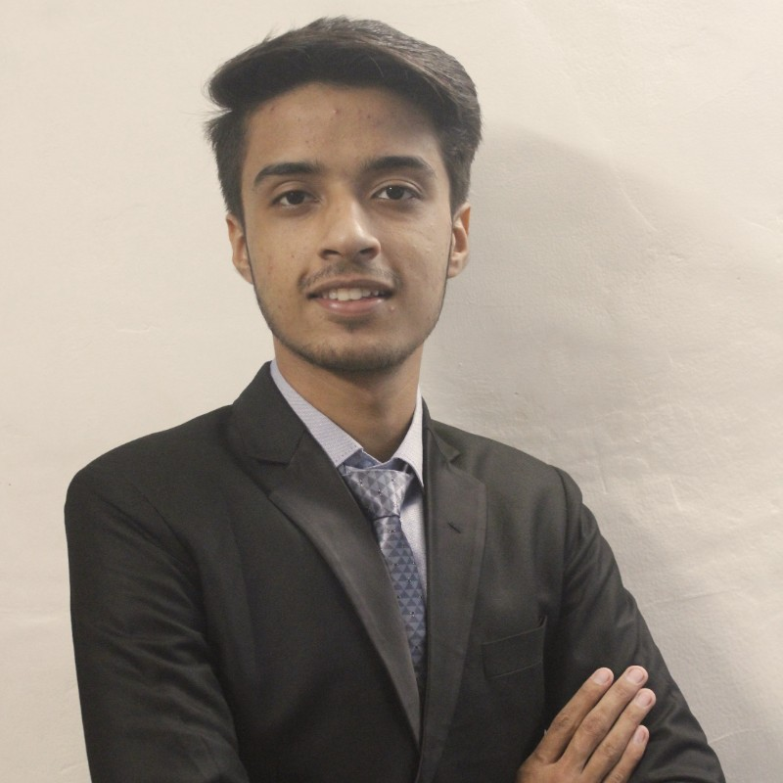
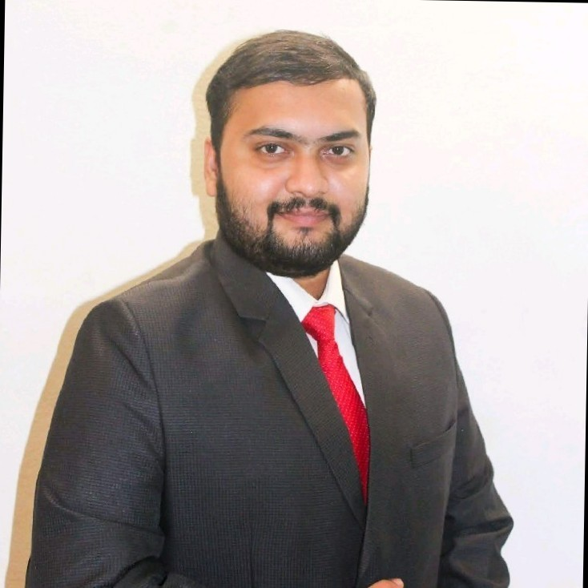
PLACEMENT CELL TEAM 2021-23
PLACEMENT TEAM SECRETARY
PANKAJ RANA
+91 9720131365
MUSLIHUDDHEEN OLAKARA
+91 9061879664
PRAGNYANSHREE MISHRA
+91 7504878133
K. NOMITHA KALYANI
+91 8360488397
VISHAL PATHAK
+91 9793821369
MALA MAHENDER
+91 8088133012
SHUBHVARDHANI SHASTRI
+91 8755015193
PAVAN D
+91 9743710168
RAMINENI HARSHITHA
+91 7498298916
SAKSHAM KATARIA
+91 7009029005
SOMESH H JAGGAL
+91 7406773898
MAYURI KUMARI
+91 9628520350
SAMBHAV KUMAR
+91 7355163604
GOURAV KUMAR PANDA
+91 8249735351
Notes:
Update slide

Slide 15
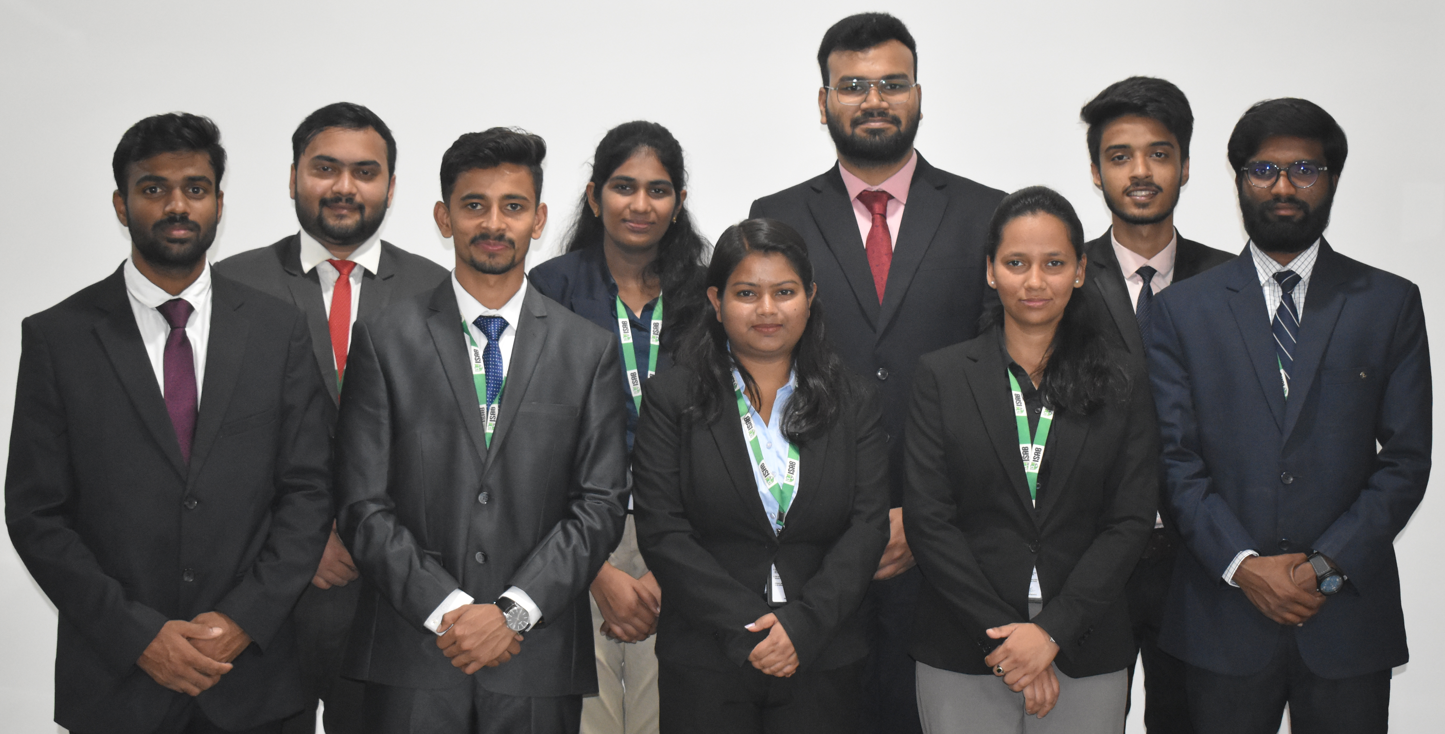
Contact Placement Cell:
Placement Secretary: Vishal Pathak
Mobile: (+91) 9793821369, (+91) 8249735351
E-mail: placementcell@isab.org.in
Notes:
Write Name & Phone numbers of all Coordinators with same template

